Slide 1
Integral Control and Disturbance Estimation
  Integral control
  Bias Estimation (or internal model) control
    Constant and sinusoidal disturbances
  Comparison of compensator design methods

Slide 2











Integral Control
Σ
Σ
Plant:
To implement integral control in this state-space system, we need to augment the state of the plant with x_{I} :

Slide 3
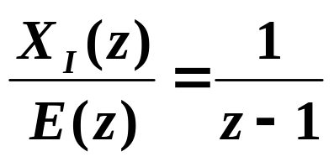

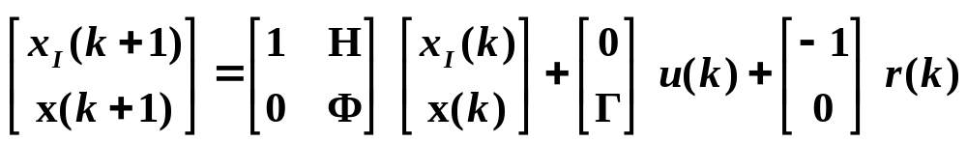
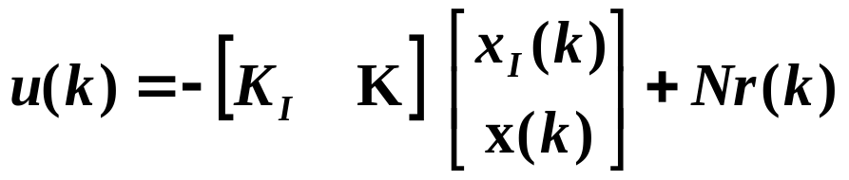
Transfer Function from E to X_{I}
pole at z = 1
Augmented system:
Control law:

Slide 4


















Block Diagram
Σ
Σ
Plant, G(z)
Σ
Σ

Slide 5
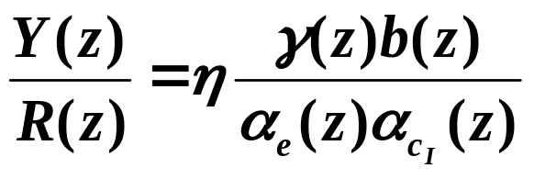
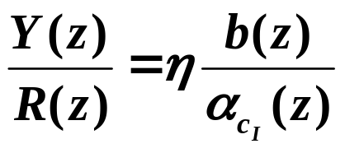
Overall System Transfer Function
In general, with integral control, the overall system transfer function is
If M = ΓN,
Integral control can improve steady-state performance of the system. But it may cause worse transient performance.

Slide 6

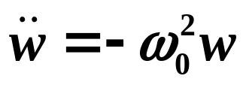
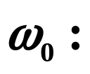
Bias Estimation (or Internal Model) Control
Plant model:
The idea is to augment the model of the system to include a model of disturbance or reference, and then cancel it out.
To approximate integral control (to lead to zero error due to a step or constant disturbance), the model to incorporate is:
To follow or reject a sinusoid signal, augment system with a more complex model:
frequency of oscillation

Slide 7
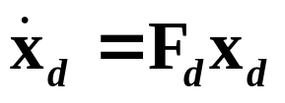
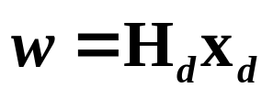
Generally, the disturbance can be modeled as:
What are F_{d} and H_{d} for a constant disturbance?
What are F_{d} and H_{d} for a sinusoidal disturbance?

Slide 8

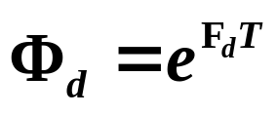

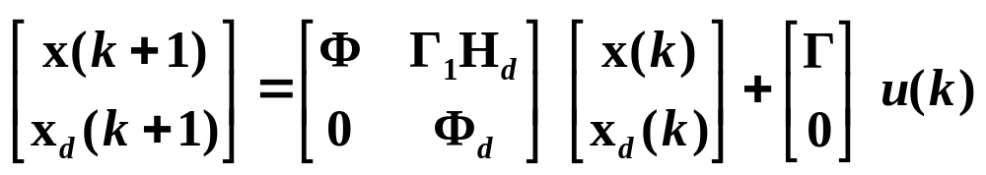
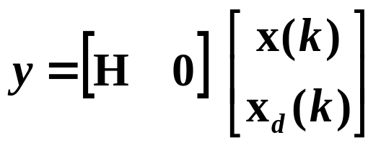
The discrete model of the disturbance is:
where
Augmented plant model:

Slide 9
Then, we can design the compensator using state-space concepts:
State-feedback design:
  Design K for the n states x(k).
  Additional states x_{d} are uncontrollable.
Estimator design:
  Design L_{p} for augmented state vector.

Slide 10


Block Diagram
Σ
Σ
Plant, G(z)
Σ
Σ

Slide 11
Compensator Design Methods
Root Locus:
Closed-loop poles constrained to move on a locus.
Bode:
Design the compensator based on BW, PM, GM
Often without even computing/knowing closed-loop poles
State-Space:
Matrix calculations to place closed-loop poles (and zeros) at desired locations
More general and powerful without specifying compensator poles and zeros
More complex

